Slide 1

Key stage 1 Transition Meeting
Mrs Aliaj and Mr Harracksingh
5th July 2022

Slide 2
Session Aims
The Early Years curriculum’s transition to the National Curriculum
The differences between Reception and Year 1
How we prepare the children
How you can prepare your child
Concerns
Expectations
Questions?

Slide 3
What is ‘school readiness’?
It is generally acknowledged that ‘school ready’ is about more than reading, writing and mathematics. Most Reception teachers would use a similar definition as the bullet points below:
School ready children:
have strong social skills
can cope emotionally with being separated from their parents
are relatively independent in their own personal care
have a curiosity about the world and a desire to learn
have a firm grounding in the key skills of communication, language, literacy and mathematics.

Slide 4
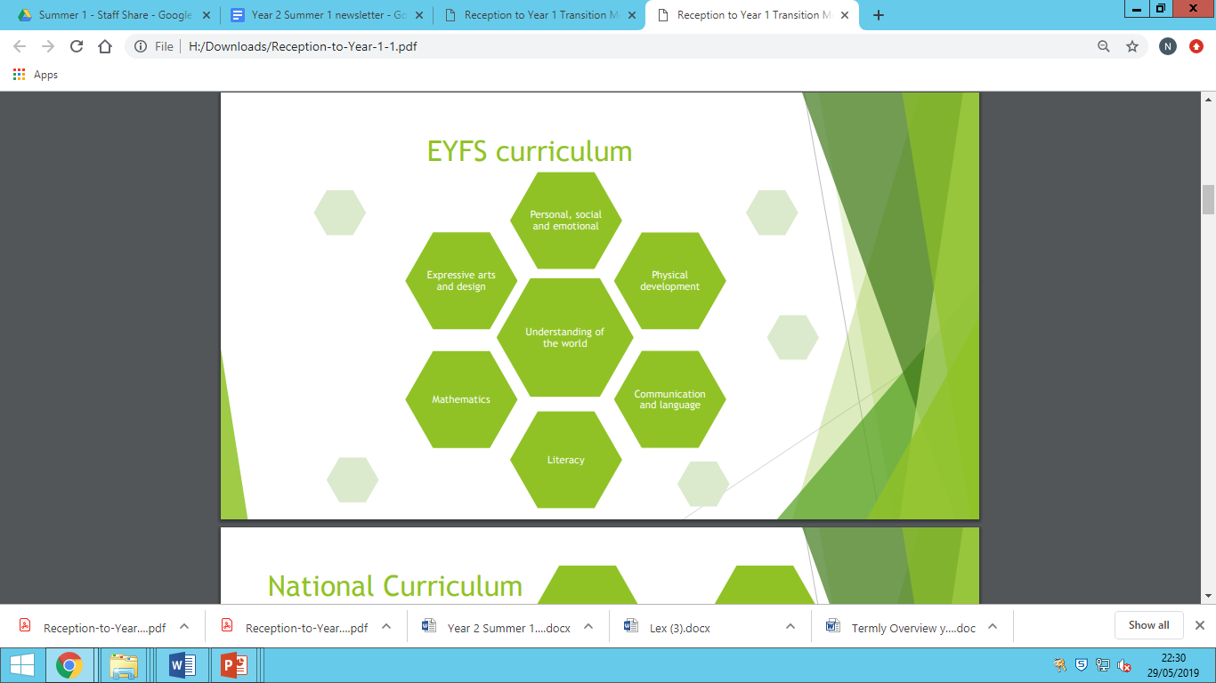
EYFS Curriculum

Slide 5
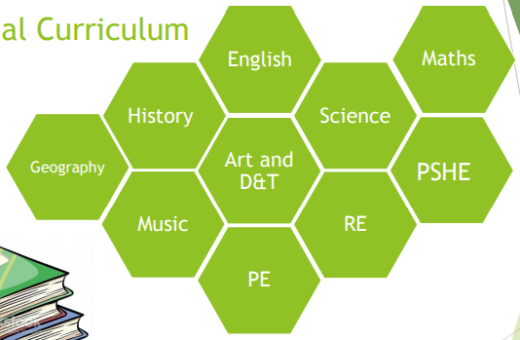
National Curriculum

Slide 6
Differences between Reception and Year 1
The principle of Early Years is learning through play. In play children link different elements of their knowledge.
Each child is unique and we support their individual approaches to learning and problem solving.
Children are encouraged to be independent in their choices of activities and resources.
The children’s day is more structured with a distinct separation between play and learning.
Children’s learning is compartmentalised into clear subjects.
Children are expected to sit for longer periods.
Children have less choice in deciding how they learn.
No continuous provision for outdoor learning

Slide 7
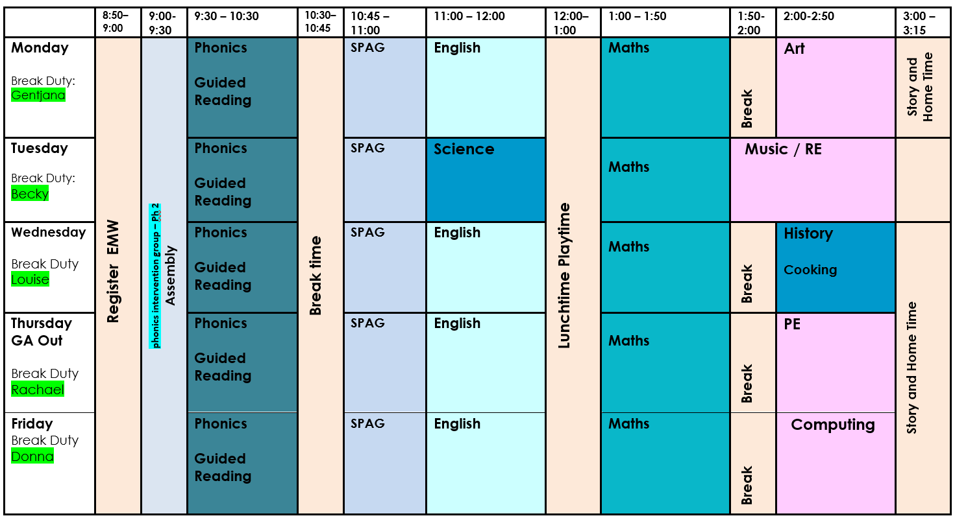

Slide 8
How we prepare the children for Transition
A process, not an event.
Planned for and discussed with children, staff and parents (parent meeting, teacher handover meeting and observations of children in reception setting, children visiting Y1 and having discussions)
There will be more whole class learning time but gradually increased. Children will still have access to outside space and particularly in the afternoons more of a free flow structure with enquiry based activities initially.

Slide 9
‘Getting children to sit down on a seat in Key Stage 1 is not a problem. But what we need to ensure is that the children are interested and excited about their learning, the children need to feel involved in what is taking place and have a level of expectation about what will happen next.’
Exciting curriculum to ensure engagement and motivation
Core text approach with hooks
Practical, fun activities- drama, use of tangible resources, exploration, enquiry, collaboration, outdoor learning, visits and events

Slide 10
How you can help support the transition:
Keep us informed of any concerns or information that may affect your child’s learning and behaviour at school
Talk to you child over the summer about the transition and what they can expect in September.
Continue to develop independence with: getting dressed/undressed for PE, toileting, washing hands.
Read on a daily basis with your child.
Keep up number work (counting, simple addition/subtraction) and phonics (through reading, recognition of sounds and writing some simple sentences)

Slide 11
Parental concerns:
Toilet times
No more outdoor learning
Less support for my child during class
Harder work

Slide 12
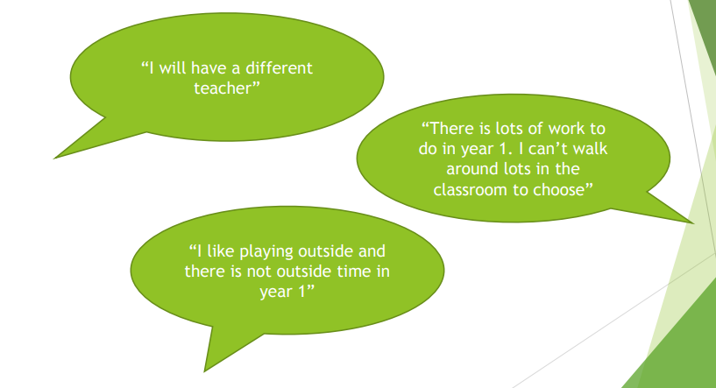
Children’s concerns:

Slide 13
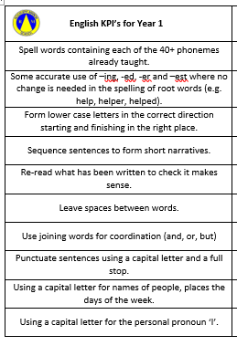
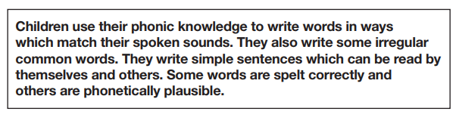
Expectations: Writing
To reach the Early Learning Goal:

Slide 14
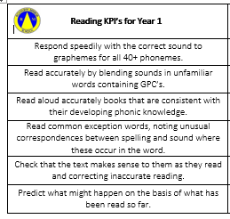
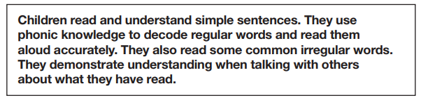
Expectations: Reading
To reach the Early Learning Goal:

Slide 15
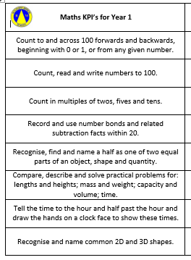
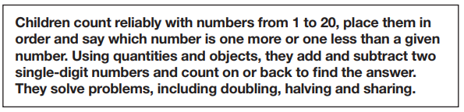
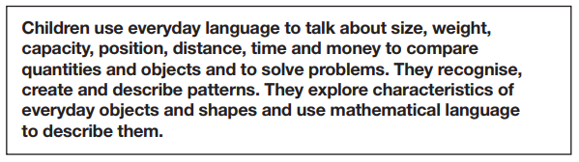
Expectations: Maths
To reach the Early Learning Goal:
Number:
Shape, space and measure:

Slide 16

Any Questions … ?
We are happy to answer any questions…
Or you could always drop us an email:
galiaj@rockliffemanor.greenwich.sch.uk – Key Stage 1 Lead
mharrachsingh@rockliffemanor.greenwich.sch.uk – Reception teacher

